Slide 1
“Code of Ethics”
Simple Acts – Leads to
Professional Mishaps!!
Redflags, Alert and road ahead
SIRC of ICAI
CA. Petchi Kannan
Chennai
6th November2024

Slide 2
Recent Case Laws
For the period from Jan 2023 to till date
Detail discussion of few case laws
FAQ related to First Schedule
FAQ related to Second Schedule
FAQ related to Miscellaneous Issues
Key takeaways

Slide 3
Who are Complainants?
Our own family members (wife, brother, aunty, uncle etc., )
Users of our services – clients and other authorities
Our own Staff members, articled trainees, co-professionals,
Total strangers, members against their own partners.
Complaints may be filed out of ego clashes, rivalry or as an arm twisting measure.

Slide 4
Case one – 11th March 2024
CA Guilty of Professional Misconduct for using Abusive Language
The Board further perused the content of the conversation shared between both the parties in Whatsapp message which reads as follows: “Tera audio tere bhaiyo ko aur teri beti ke sasuraf bhej diya hai maine.Teri kartut tere gharwalo aur tere relative ko bhej raha huu.”“Mahila aayog mai ek letter jama kara diya ha/ maine tere audio ke sath.Mai soch raha huu ek complaint ED, CBI, Interpol ko bhi bhej duu kyu ki tuu Dubai ka don hai na”“Tera naam to mujhe ICAI ki history main dalwana hai.Tujhe to mai Dubai tak mashhur karna chahta huu.”Maine pichle 7 mahine see tere aur tere dosto aur relatives ko msg bhejkar pareshan kar Rakha hai. Abb mai teri iss pareshani ko khatam karne jaa raha huu. Monday see tere paas our tere jankar logo ke paas abb koi msg aur call nahi aaye gaa.Mai bhi thaak chukka huu tum jaise ganduo koo samjha samjha kee but kutte ki tedi puch bhi sidhi nahi ho saktiYadi main nahi too tum bhi nahi”

Slide 5
Case one – 11th March 2024
I have sent your audio to your brothers and your daughter’s in-laws. Sending details of your deed to your family and relatives. I have submitted a letter in Women’s Committee with your audio. I am thinking of writing one complaint to ED, CBI, Interpol as well cause you are Dubai’s Don right. I will get your name in the history of ICAI. I want to make you famous till Dubai. I have been troubling you, your friends and your family members since last 7months. Now, I am going to end up this trouble of yours. Monday onwards you and your acquaintances will not get any message or call. I am also tired making fuckers like you understand but a dog’s tail can never be straight. If I am not then you not
Be very careful while texting and speaking with client

Slide 6
Case Two – 10th February 2024
File No: PR/223/2016/DD/75/2017/BOD/680/2023
Complainant: Saiprakash Pasumathy - MD of Acumen Software Technologies Ltd
The Respondent: CA.P.Venkata Siva Ramamurthy (M.No: 028996)
Started a company together, in 1995 share percentage changed in ROC 2003 without notice of another director, transferred share to his wife, started new company as competitor.
Between Own Brothers
It is held Respondent NOT GUILTY of Profession
More than 8 years of stress

Slide 7
Case Three – 22nd December 2023
File No: PR/G/130/2022/DD/105/2022/DC/1737/2023
Complainant: V Annapoorna, Deputy Registrar
The Respondent: CA. Durga Krishnamurthi, Chennai
Incorporation of a company with fabricated documents as proof of address.
It is held Respondent NOT GUILTY of Profession
Helping Clients out of the way leads to face litigation anytime

Slide 8
Case 4 & 5 – 22nd December 2023
File No: PR/G/130/2022/DD/105/2022/DC/1737/2023
Complainant: V Annapoorna, Deputy Registrar Bengalure
The Respondent: CA. Durga Krishnamurthi, Chennai
Incorporation of a company with fabricated documents as proof of address.
It is held Respondent NOT GUILTY of Profession
File No: PR/G/301/2022/DD/215/2022/DC/1677/2023
Complainant: Mangal Ram Meena, Deputy Registrar Delhi
The Respondent: CA. Durga Krishnamurthi, Chennai
Incorporation of a company with dummy persons as subscribers to MOA.
It is held Respondent NOT GUILTY of Profession however the respondent was cautioned that any procedural lapse should not occur in her future assignments
Helping Clients out of the way leads to face litigation anytime

Slide 9
Case Six – Feb’2024
File No: PR/232/2021-DD/257/2021/DC/1603/2022
Complainant: Shri Deepak Mehra (client)
The Respondent: CA. Manoj Kumar
Filing of income tax return, offered the capital gain as sale of agriculture and claimed refund of tax paid by client himself. Evidence is there for the discussion to save tax under section 54 by depositing amount in Capital Gain Scheme account
Mails evidence, received refund and only when there is query from IT department he is filing case against the Respondent to safeguard himself.
It is held Respondent NOT GUILTY of Profession
Filing of Refund IT Return needs to analyze thrice

Slide 10
Case Seven – Feb’2024
File No: PR/82/2018/DD/127/2018/DC/1597/2022
Complainant: C.B. Rawat (Representative Society)
The Respondent: CA. Sachin Jain
Adverse opinion given for society audit, audit report stated Delhi Co-oprative Societes Rule 1973 instead of 2007
Not having impact in financial statement
It is held Respondent NOT GUILTY of Profession
Need to be cautious about amendments of Acts while signing

Slide 11
Case Seven – Feb’2024
File No: PR/82/2018/DD/127/2018/DC/1597/2022
Complainant: C.B. Rawat (Representative Society)
The Respondent: CA. Sachin Jain
Adverse opinion given for society audit, audit report stated Delhi Co-oprative Societes Rule 1973 instead of 2007
Not having impact in financial statement
It is held Respondent NOT GUILTY of Profession
Need to be cautious about amendments of Acts while signing

Slide 12
FAQ RELATED TO FIRST SCHEDULE
Member to share profits with the widow of he deceased partner- allowed
Sharing of fees between widow or the legal representative of proprietor with purchaser of the GW of the firm – not permitted
CA in practice can enter into partnership with Practising CA of a recognised Foreign professional body to share their fee as per partnership – allowed
LLP is doing commercial activity – Practicing CA cannot be partner - not permitted
CA along with CA Firm name can be used on the greetings card or invitation
A CA firm can give advertisement in any newspaper or newspapers in relation to Silver, Diamond, Platinum or Centenary Celebration of the firm – permitted

Slide 13
FAQ RELATED TO FIRST SCHEDULE
1. Member can appear on TV, Internet and broadcast in Radio – can tell he as CA with Firm Name – but should not be like promotional of him or his firm but must be an objective professional view of the topic under consideration
2. CA member handed over his professional bio-data to the Chairperson during the interview and that Chairperson read his Bio-data at the TV interview itself – read of expert in taxation Professional violation
A CA member in practice posts the particulars of himself/ itself (in case of firm) and his Photograph on a website
It is permitted by ICAI that the website of CA member can provide link to the website of ICAI, its Regional Office and branches and also to the websites of Govt/Govt Departments and professional bodies. CA or Firm of CA is not supposed to use the “catchwords” or “Catch Phrases” in the website, Letterheads and visiting cards – say excellence in particular area, man of integrity etc).
CA member in practice circulate the information contained in the web site on their own or through e mail or by any other mode or technique – NOT ALLOWED

Slide 14
FAQ RELATED TO FIRST SCHEDULE
Vision and value of CA should not be printed behind the visiting cards
Member in practice should not express him as IT consultant, Cost Accountant, Company Secretary, Cost Consultant or Management Consultant
A CA in practice should not mention his Date of commencement / Date of establishments in his letterheads and other professional documents etc
Member In practice is not supposed to use Logo on LH/Stationary
Member in practice can use common CA logo
Visiting Cards – No photos permitted
Member give advertisement in newspaper to recruit personnel – permitted
Member can not accept the position as auditor previously held by another CA without first communicating with him in writing – Through UDIN approved and waiting for procedural aspects
Audit fee of previous auditor is pending – not to accept audit by CA

Slide 15
FAQ RELATED TO FIRST SCHEDULE
Tax auditor appointment of previous auditor – get concurrence
Phone communication is not sufficient to Previous auditor
Fees should not be charged on % of TO
Other than profession, no business is allowed
A member in practice can not be appointed as whole time directors of the company but he can be Director Simplicitor
CA in practice is entitled to accept teaching assignment
CA member who is working under another CA can hold COP but he is not allowed to do any attest function
Member in Practice own IPR of domain names – sells these to others – not permitted as it is business
Member let out his HUF property to the co where he is statutory auditor – permitted but suggested to avoid
ICAI asked particulars – member refused/ failed to furnish – held guilty
Writing script/ story for a movie – Get ICAI permission

Slide 16
FAQ RELATED TO SECOND SCHEDULE
Working papers of the Auditor – No it can’t be given access to Client or main auditor of (It is the property of Auditor)
Joint auditor should not demand working papers of other auditor
Joint auditor is not responsible for the work done by other auditor, but responsible only
when work is not divided
CA in service should not accept or agree to accept any part of fees, profits or gains from a lawyer, CA or broker engaged by such company, firm or person or agent or customer of such company, firm or person by way of commission or gratification
Project report to be signed or not: A member in practice permits his name or the name of his firm to be used in connection with an estimate of earnings contingent upon future transactions in a manner which may lead to the belief that he vouches for the accuracy of the Forecast – Not allowed – advised to comply with SAE 3400

Slide 17
FAQ RELATED TO SECOND SCHEDULE
CA is appointed as Liquidator – he can’t do the audit of that company
CA is working as a part – time lectureship in the college – Guilty if he accepts the audit of that college.
CA’s partner is employee or trustee of the trust - Guilty if he accepts the audit of that trust.
CA is Director of the Company - Guilty if he accepts the audit of that Company
Relative of CA is a director, or is in employment of the company as a director or KMP - Guilty if he accepts the audit of that Company
Auditor is doing Audit apart from that he is doing Management consultancy services (MCS) separately – Fees of MCS exceeds audit fees – permitted
Can the statutory auditor accepts system audit of the same unit – Allowed

Slide 18
FAQ RELATED TO MISCELLANOUS ISSUES
Salary employee of CA – can hold COP but not supposed to have attest function
A member in practice can be promoter/promoter director of the Company- Not required to obtain specific permission of ICAI – can hold any number / percentage in the company
CA member in practice can be a sleeping partner in family business- specific permission from council is must – not allowed to do attest functions.
Internal auditor can not be appointed as Tax auditor
Member in Practice can own Agricultural land and also do agricultural activities
Member in Practice can establish “Tax Information Network – Facilitation Centre (TIN-FC) as well as its franchise
Can member in practice engage GST Practitioner – Permitted
Member holding COP (employee in CA firm) – permitted to be enrolled as GST Practitioner
Member is not permitted to mention himself as “GST Consultant”
Firm of CA not to be allowed to sponsor an event except with the approval of CPE directorate of ICAI
QR code in Visiting Card is permitted for easy access of information

Slide 19
In the Code of Ethics, 2009, safeguards to be considered for threats other than “clearly insignificant” (defined as ‘trivial or inconsequential’)
In the revised 2019 Code, the application of safeguards required to eliminate threats or to reduce them to ‘an acceptable level’
“Acceptable level” defined as a level as the reasonable and informed third party knowing facts would likely conclude that the accountant complies with the fundamental principles.
Safeguards

Slide 20
Key Takeaways
Objectivity
Professional competence and due care
Integrity
Confidentiality
Professional behavior

Slide 21
Key Takeaways
Common questions by all:
If another person is not following why should I follow?
If I have not accept this client, he will get it from other CAs?
Why should I loose my revenue?
In this increased era, more participation by the government, NAFRA implemented, New ethics – would you like to compromise on sweat, prestige, peace, happiness of life etc.,
Losing a Client:
Emotional disturbance for a day
Professional disturbance for a month
Financial disturbance for a year
Minuscule at times may lead to massive destruction

Slide 22
One Mantra – Self Consciousness
Be Cautious while signing – double check before signing
Documentation make it more perfect to safe guard you
We are working in very Sensitive area, NO emotional attachment with clients – you should know to say “No”
Self imposed discipline is most appropriate than enforced Law

Slide 23
Be Aware…….
Now a days heart attacks occurring for youngster and middle age in large:
To minimize the risk of heart attack, you should take some precautionary measures :
Do not over-exercise. Exercise for the prevention of heart disease should be done regularly and its intensity should be gradually increased as the body's tolerance and stamina improves.
Sleeping for at least 7-8 hours is necessary for overall well-being.
Smoking and alcohol intake should be avoided completely.
Reduce mental stress by doing regular yoga and other stress management exercises.
To keep you hydrated, drink plenty of water throughout the day.
Also, keep sugary drinks and excessive caffeine intake under check.
Stress – worried, sad, unhappy

Slide 24
Life is too short – Live it…..
Family time
Work 8-10 hrs
Gratitude

Slide 25
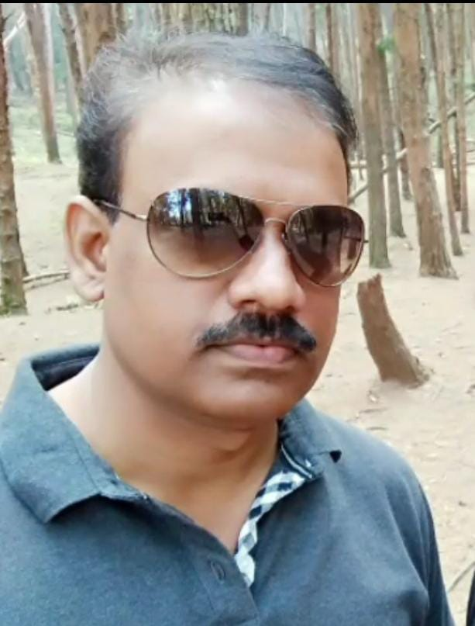
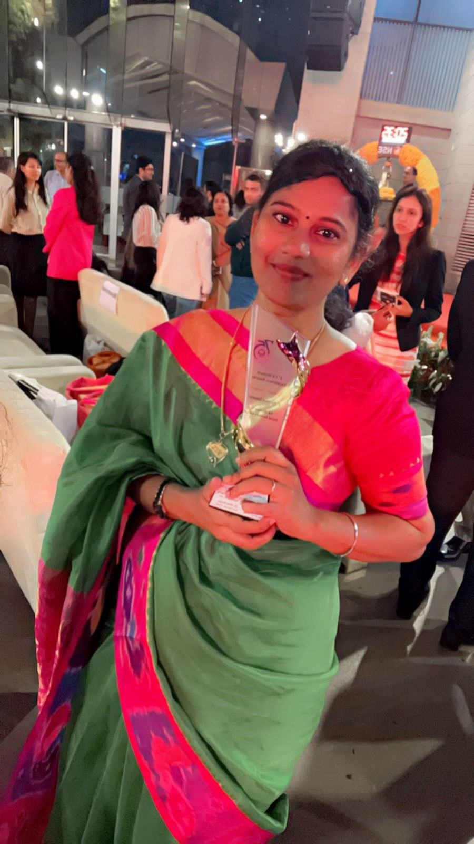
Who made me, what I am today

Slide 27
CA. Petchi Kannan
email id – petchi@icai.org

